Slide 1
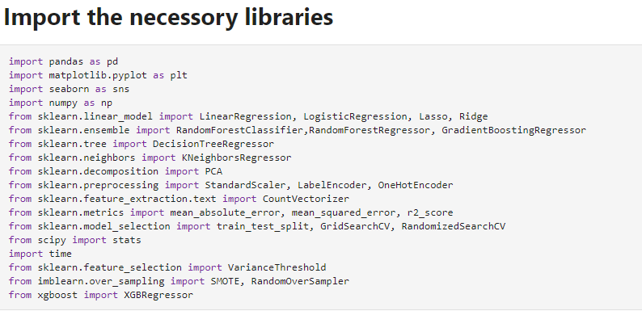
Project Title : Smart Predictive Modeling for Rental Property Prices Prepared By : SURIYAKRISHNAN Project Justification : In This project to predict the cars Price its depends on the cars features, and this is a Regression datasets(Regression problem).
Project Requirements :
Dataset
Python’s libraries(necessory)
Import necessary libraries:
First need to import or load the necessary and related libraries, Some very primary and almost necessary packages for Machine Learning are — NumPy, Pandas, Matplotlib and Scikit-Learn.

Slide 2
Dataset details:
Dataset file: ‘House_rent_train.csv’ and House_rent_test.csv
This is a regression data set.
The data set has 20555 samples.
There are 25 features.
The target variable is the rent of the House.
Dataset Description:
1. id: A unique identifier for each property listing.
2. type: The type of property, such as BHK1, BHK2, RK1, etc.
3. locality: The specific neighborhood or area where the property is located.
4. activation_date: The date when the property listing was activated or made available for rent.
5. latitude: The geographic latitude coordinate of the property's location.
6. longitude: The geographic longitude coordinate of the property's location.
7. lease_type: The type of lease, such as FAMILY or BACHELOR, or ANYONE
8. gym: Indicates whether the property has a gym or fitness facility.
9. lift: Indicates whether the property has an elevator or lift.
10. swimming_pool: Indicates whether the property has a swimming pool.
11. negotiable: Indicates whether the rent price is negotiable.
12. furnishing: Describes the level of furnishing, e.g., fully furnished, partially furnished,
unfurnished.

Slide 3
Dataset Description:
13. parking: Specifies the availability of parking facilities.
14. property_size: The size of the property in terms of square footage or square meters.
15. property_age: The age of the property since construction.
16. bathroom: The number of bathrooms available in the property.
17. facing: The direction in which the property faces, e.g., north, south, east, west.
18. cup_board: Indicates the presence of cupboards or storage units.
19. floor: The floor number on which the property is located.
20. total_floor: The total number of floors in the building.
21. amenities: Additional amenities or features provided with the property.
22. water_supply: The type and availability of water supply.
23. building_type: The architectural style or type of building, e.g.,Apartment, Individual House
24. balconies: The number of balconies or outdoor spaces.
25. rent: The target variable, representing the rental price for the property.

Slide 4
Once the libraries are loaded, need to get the data loaded. Pandas has a very straightforward function to perform this task — pandas.read_csv. The read.csv function is not just limited to csv files, but also can read other text based files as well.
Explorary Data Analysis:
To check how many duplicates values in the dataset
This dataset have a many unvalid values in the features{?}. All the unvallid entries go replace np.Non-values.
19 columns are having null values randomly and here there many columns null are directy dropped based on feature selection and also that values are affecting the predictions
Locality column having more null values in this case predicted the null vaues using randome forest regressor.
After predicted the locality column Null values then the original data and predicted locality dataframe has merged
Using feature selection to dropped 3 columns based threshold = 0.005 , thease 3 three columns are belove 0.005
Evaluation:
have used
RandomeForest Regressor
GradientBoostingRegressor
LinearRegression
XGBBoost Regressor
DecisionTreeRegressor

